Slide 1
HTML
T-LeVEl

Slide 2
How are web pages made?
HTML stands for Hyper Text Markup Language
It describes structure

Slide 3
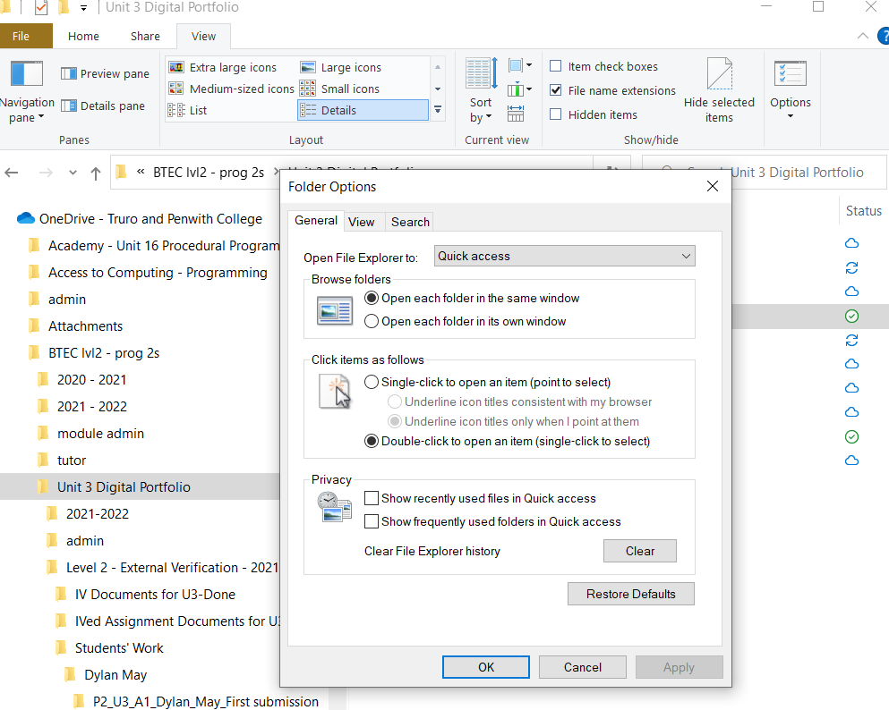

Slide 4
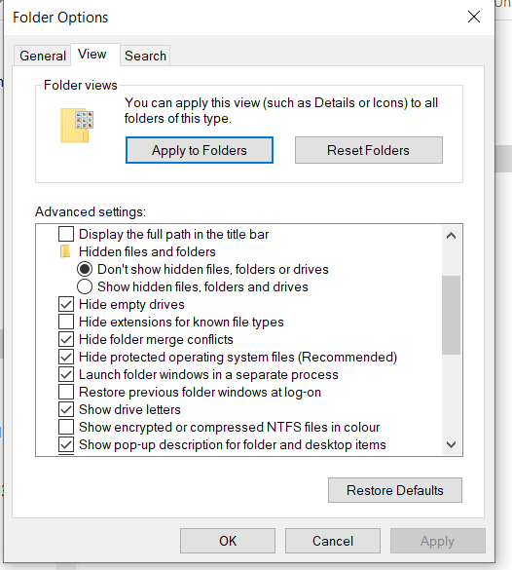

Slide 5
Building your first web page
Open notepad
Type in the following:
<p>
hello world!
</p>
index.html
Save it as

Slide 6
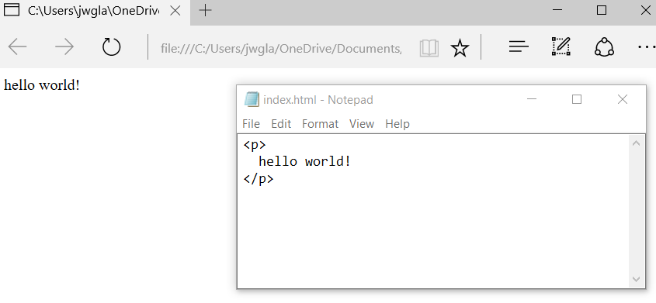

Slide 7
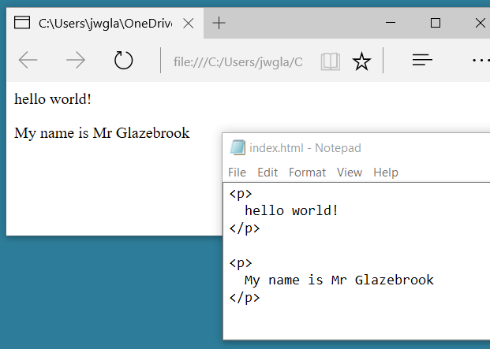

Slide 8
Client side
Browser
HTML
CSS
js

Slide 9
Can you answer the following
What is HTML and css?

Slide 10
HTML & CSS
Hypertext Mark-up Language (HTML) describes the structure of a web page.
Cascading Style Sheets allow you to create rules that specify how a web page should appear.

Slide 11
JavaScript
JavaScript is a client side scripting language.
Client side scripting languages are used to add extra functionality to web pages:
Form checking
Animation

Slide 12
Things to note
HTML tags come in pairs
An open tag
A close tag
<p> is a paragraph tag
<p>
hello world!
</p>

Slide 13
Experiment with the following tags
<p> hello world! </p>
<p> this is <b>bold</b> text </p>
<p> this is <i>italic</i>. </p>
You and your hobbies!

Slide 14
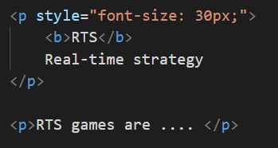
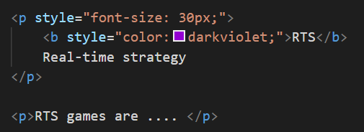
Advanced techniques

Slide 15
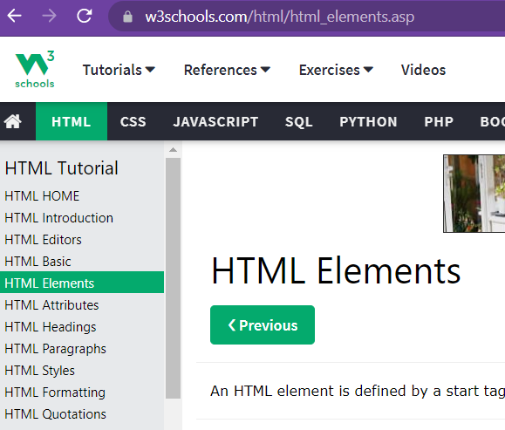

Slide 16
